Slide 1
The Customer Centric Organization
Tori Dargati, Enterprise Vice President

Slide 2
A Tip from Jeff Bezos….
“Have the courage to start
with the customer and work backwards…”

Slide 3
Customer Centric Brands
More than good service
Culture created around the customer
Great experience through the awareness, purchasing and post-purchase processes
Putting the customer first at the core of the business

Slide 4
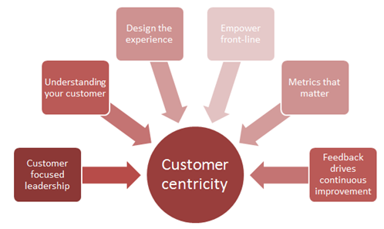
The Look of Customer Centricity

Slide 5
Starting with the Customer at the Core
Organizations believe that without the customer, they cannot succeed in business and want to see the world through the customer’s eyes
Marketers inside customer-centric organizations understand what customers want, and use customer data to capture customer insights and share this across the organization.
Brands that are committed to customer centricity focus on what the customer wants and needs, and develop products and services around that.
Brands that are committed to customer centricity analyze, plan and implement a carefully formulated customer strategy that focuses on creating and keeping profitable and loyal customer

Slide 6
Creating the Culture
Everyone has to work in a Call Center
Respect Today’s Customer
Don’t Be Afraid to Apologize
The Empty Chair: The Most Important Person in the Room
Never Settle for 99%

Slide 7
Looking in the Mirror

Slide 8
Owens & Minor – 134 Years Old
In the late 1880’s, Richmond Virginia was at the center of drug wholesaling in the South
Otho Owens and Gilmer Minor were both talented young salesman who worked for competing companies
They admired one another talents and began discussing coming together to start their own business
In 1882 they launched Owens & Minor
“Connecting the World of Medical Products to the Point of Care”

Slide 9
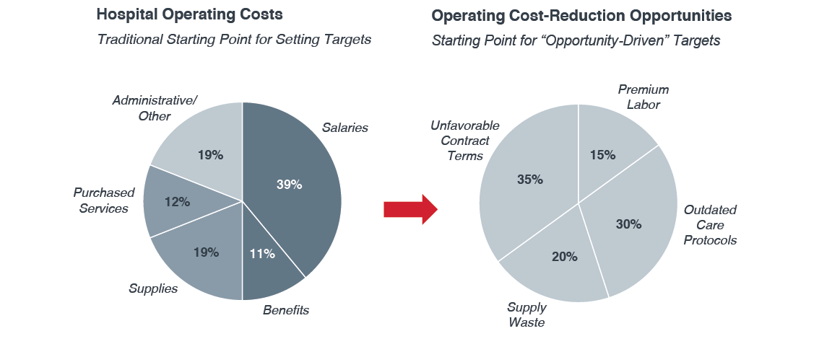
Changes in Customer Demands Require
Transformational Ideas
Source: The Advisory Board Company, “Untapped Opportunities for Saving Millions, Guide to High Impact Cost Reduction Opportunities”

Slide 10
Corporate Branding Success Criteria
An effective branding strategy will accomplish the following:
1.
2.
A more clearly defined Owens & Minor brand vision as a leader in healthcare services
A more consistent and higher level of awareness among healthcare decision makers and providers
3.
4.
A reframing of O&M’s services as best-in-class
A clear separation from our competitors

Slide 11
Branded House Rational
This approach is more effective in linking operating initiatives and creating relevance in the C-Suite.
Customer Centric
Allows customers to understand Owens & Minor offerings
Full-Line Positioning
Reinforcing Owens & Minor as a full-line healthcare solutions provider
Growth Arenas
Leveraging a singular brand identity to drive growth by adding value to new ventures, acquisitions or partnerships

Slide 12
Voice of the Customer – The Purpose
Gather real time feedback on Executive’s perceptions and expectations of Owens & Minor
Cross section of customers:
  Number of Current Accounts: 7
  Number of Pursuits : 3
  Aggregated Distribution Volume: $500M
  Classification: 3 Academic, 4 Non Profit, 3 For Profit
  GPO Memberships: 3
  Average Years as an Owens & Minor Customer: 16
Serve as the foundation for a variety of initiatives beyond brand strategy

Slide 13
Focus Questions
What is your knowledge/understanding of Owens & Minor’s Strategic Vision?
What information are you looking to your supplier partner to present in a business review and how often?
Do you regularly meet with supplier partners and if so for what purpose?
What are your thoughts on your supplier partner taking an advisory approach and providing trends and insights for their specific areas of expertise?
It is our understanding from other healthcare executives that the following strategic imperatives shape and guide their organizations overarching strategy. Do these resonate with you? Are there any that you would add or exclude?
It is our understanding from other healthcare executives that the following metrics would be most relevant in evaluating the performance of their Supply Chain. Are there any metrics that you would include or exclude? What SC metrics do you find most vital to your organization?
What role do you see Supply Chain in being an asset to your organizations overarching strategy?
Notes:
What is your knowledge/understanding of Owens & Minor’s Strategic Vision?
What information are you looking to your supplier partner to present in a business review and how often?
Do you regularly meet with supplier partners and if so for what purpose?
What are your thoughts on your supplier partner taking an advisory approach and providing trends and insights for their specific areas of expertise?
It is our understanding from other healthcare executives that the following strategic imperatives shape and guide their organizations overarching strategy. Do these resonate with you? Are there any that you would add or exclude?
Value Base Management
Budget Expense/Control
Organizational Bandwidth – Driving Productivity
Top Line Growth
Population Health
It is our understanding from other healthcare executives that the following metrics would be most relevant in evaluating the performance of their Supply Chain. Are there any metrics that you would include or exclude? What SC metrics do you find most vital to your organization?
Supply expense/ per adjusted discharge
Supply expense as percentage of gross revenue
Supply expense as percentage of net revenue
Supply expense as percentage of operating expense
Supply expense, per case mix index adjusted discharge
Supply expense per CMI-adjusted patient day
Supply expense per adjusted patient day
Operating margin impact (percentage of operating margin that is attributed to supply chain cost savings)
Owned Inventory Reductions
Cost per Procedure
Waste/Obsolesce as a total % of inventory
Freight costs versus the prior year
# of FTE’s associated with supply chain activities as a % of SCM
What role do you see Supply Chain in being an asset to your organizations overarching strategy?

Slide 14
Key Insights From Executives
I would like both my GPO and Supplier partner to be far more synergistic. You both have a set of assets and capabilities, and there are enough cost savings projects for both of you to work on together. You are competitors in some areas in your portfolios, but then you both have areas where you can augment the other.
Our Value Analysis teams are at the center of the financial , clinical, and supply chain functions. We rely heavily and draw on these resources to analyze the value of products in delivering high quality cost effective care. And, critical to a successful program is a source of robust and extensive data , quality data.
I interpret your vision as connecting to the patient, so your vision is aimed at developing a patient – centered supply chain.
We are investing in the continuum of care, and we expect our partners to do the same: lab, radiology, home health, hospice and a very complex primary care network
Every single executive needs to be more innovative in balancing costs and quality. implementing nontraditional solutions is where Disruptive innovation comes into play
If I were in your shoes, I would give insights and your companies’ perspectives on the different business models that you are seeing from where you sit. What are areas that we should look at for growth and expansion? Are there external factors in the regional market that I should be aware of?
Don’t make me feel like you are nickeling and diming me. We both have to win and make money. Lets be transparent in what each of us needs in order to walk away with a win.
Make sure your value proposition and acquisitions align with the Triple Aim focus of healthcare reform — decreasing cost, increasing quality and enhancing patient experience

Slide 15
Voice of the Customer Executive Summary Results
Understanding of Vision
Limited understanding of strategy and vision
Relate vision to customer’s strategy and financial goals
How does it drive continuum operational efficiencies?
Hospitals are patient-centric, is the strategy patient-centric?
Partnership Strategy
    Need synergy with GPOs, augment contracting
    Approach as trusted advisor, not selling services
    Be an asset/transform SC into an asset
    Lack of synergy with insurers, payers – follow population health
    Move towards retail settings
Business Review Metrics
  All metrics aligned with FY goals
  Collaborate better with customer’s value-based dashboard
  Have bi-annual strategic business review with c-suite/be present
  Align with c-suite strategic imperatives and values
  Align with financial metrics
Partnership
Customer
O&M

Slide 16
Translating Theory into Practice

Slide 17
Customer Mapping Clarifies and
Prioritizes the Best Account Strategy Elements
Gain Creators
Gains
Transformational
Ideas
Value Prop
Health System
Tasks, goals,
objectives,
voice of the
customer
Pains
Pain Relievers
Assembling and managing our resources, capabilities, and technologies to deliver a comprehensive solution
Account profile

Slide 18
Health System Profile
Gains describe the outcomes customers want to achieve or the concrete benefits they are seeking
Unify non-acute and acute
Reduce expenses $15M over next three years
Address PPI variability
Create data warehouse of acquired hospitals
Reduce inventory in clinical areas
Cost per case visibility
Reduce supply expense $10M
Reduce services expense $5M
Prepare for bundled payment
Enhance logistics
Reduce clinical involvement
Reduce complex handoffs
Implement technology in clinical
Value Prop
Health System
Lack of VAT momentum
No clear PPI strategy
Process to reduce inventory undefined
Lack of data connectivity
Lack of resources to accomplish tasks
Customer tasks describe what customers are trying to get done in their work as expressed in their own words
Pains describe bad outcomes, risks and obstacles related to key tasks
We achieve when our value map meets our customer profile-when our products and services produce pain relievers and gain creators that match with tasks, pains and gains that are important to our customer

Slide 19
CCG
Value Proposition Map
Reduce total supply expense
Reduce inventory, expired and obsolete product
Enhance logistics for better clinician support
Improve flow path of product internally
Reduce operational rework
Share risk around solutions
Redeploy critical supply chain labor
Create aggregation opportunities
Solution architect focused on opportunities
Create plan
Create relationship focus on patient quality, delivery and cost
Unify the supply chain and remove the end user from the process
Strategic partnership involving gain share on savings
Enterprise Model
Qsight to reduce clinical inventory
HCIQ, Benchmarking, Parity, to link acquired hospitals
Cost per case
Bulk buys to reduce expense
Assigned solution architect
Par optimization
Kitting standardization
OR diagnositic study
Logistics study
Data cleanse
Value stream mapping for complex handoff’s
Kaizan events to solve opprotunities
Operational teammate assigned
LUM services to reduce labor and inventory
Value analysis support
Purchased services study
Success sharing
Gain Creators
Eliminate manual supply chain processes in clinical areas
Reduce expired obsolete inventory
Eliminate noise around operational issues
Reduce unjustified variation in kits
Reduce budget stress around total supply expense
Eliminate pricing variety from manufacturers
Reduce delays, quality of care issues due to supplies
Error proof the standard work, reduce cost, t
time, and space requirements
Pain Relievers
Notes:
A value proposition map describes the features of a specific value proposition in our business model in a structured and detailed way.
It breaks our value proposition down into products and services, pain relievers, and gain creators.

Slide 20
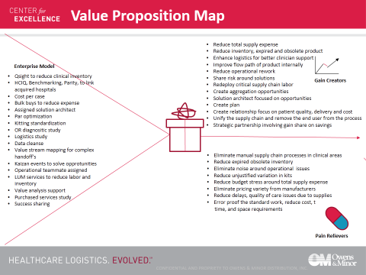
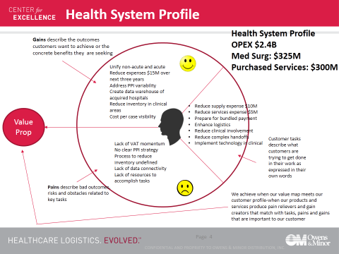
Completed Customer Mapping

Slide 21
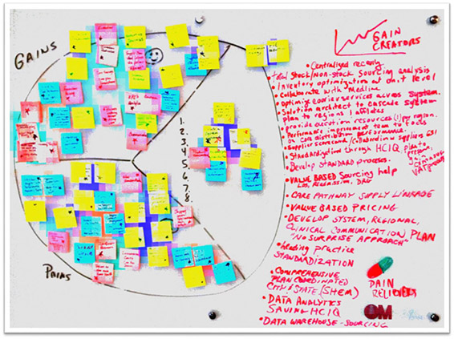
Creating Alignment

Slide 22
The Consumer Centric Supply Chain

Slide 23
Winning Organizations Know….
Who are YOUR Customers?

Slide 24
Materials Management Customer Satisfaction Survey

Slide 25
Supply Chain Perceptions
50% of staff nurses feel they spend too much time on supply chain activities
61% of nurse executives feel there staff nurses spend too much time on supply chain activities
Only 20% of each group disagrees.

Slide 26
Searching Impact
During each shift, 70% of nurses spend 5% -20% or more of their time searching for patient care supplies.

Slide 27
Non-clinical Tasks
Nurses are least satisfied with:
Put-Away
You can address these issues with:
Process Improvement
Managing Expiration & Lot Numbers
Searching for Supplies
Inventory Management

Slide 28
Feel Empowerment
48% of nurse executives
perceive their staff nurses “empowered” to change the supply chain; 41% do not.
These execs feel similar ambiguity about their own influence over the chain.

Slide 29
Accountability
Most prefer to share accountability
for supply chain performance.

Slide 30
Nurse Satisfaction
Nearly 90% of staff nurses state that supply chain issues influence their job satisfaction.
Staff Nurses
Nurse Execs
Nearly 90% of nurse executives feel supply chain issues impact the satisfaction of their staffs.

Slide 31
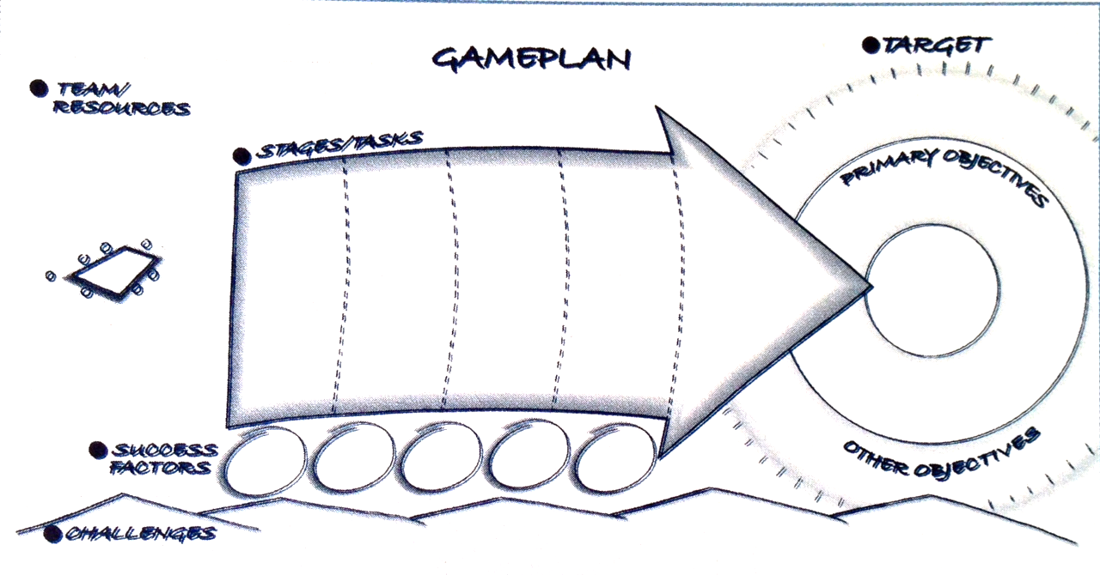
Focusing on the Customer’s Agenda
Growth GAMEPLAN
INVENTORY
RFID
BUNDLED PAYMENT
WORK SPACE
CONNECTIVITY
ACCESS TO STAKEHOLDERS
CLEAR & ELEVATING GOAL
NOT RESOURCE DEPRIVED
KPI’S
OPTIMIZED LOGISTICS
ANALYTICS
PPI & CONSIGNMENT
SERVICE LEVELS
SYSTEM PLAN
REGIONAL PLANS
INVENTORY
LUM
PREFERENCE CARDS
COURIER
KPI’S
NEW EDUCATION
SOLUTION ARCHITECT
CENTRALIZED RECEIVING
ANALYTICS
LABOR TIMING
PAR OPTIMIZATION
NEW RESOURCES
STANDARDIZATION
ORDER CONSOLIDATION
CHANNEL OPTIMIZATION
PRICING ACCURACY
CARE PATHWAY
LEAD LOGISTIC PROVIDER SERVICES
DEMAND DRIVEN
SERVICE LEVELS
LOGISTICS
DISASTER PLANNING
CENTRAL RECEIVING
ANALYTICS
DEMAND DRIVEN
LUM
LEAN
SUPPLY
CHAIN
PPI MGMT
Network Structure
EXPENSE REDUCTION
BETTER
FLOW
PATH
STANDARDIZATION
DATA DECISIONS
LINK TO GOAL
MUTUAL BENEFIT
LEADERSHIP IN KEY POSITIONS
GOVERENANCE STRUCTURE
TECHNOLOGY
ANALYTICS
NEED TEAM GOALS
CREATE ACCOUNTABILITY
STAKEHOLDER ENGAGEMENT
COMMUNICATION

