Slide 1
Presentation

Slide 2
Company Snapshot Leading Developer and Operator of Advanced Wound Care Centers
Nationwide footprint of 120 centers in 24 states
Strong regional density in the Northeast, Upper Midwest and California
Contracts with acute care hospitals that provide the site for the center
Locating inside the hospital maximizes patient referrals
Manages all center-level activities
Employ all non-physician staff
Marketing and education to drive patient volume
Information technology
Clinical oversight to promote quality outcomes
Over 240,000 procedures per annum
Exceptional contract retention
98% retention rate over last 2 years
Existing Centers
Centers Under Development
Headquarters
Notes:
Todd
Also add commentary on AOSS/Competition

Slide 3
Partner of Choice to Hospitals “Turnkey” Solutions: 98% Contract Retention Rate
Partnering with RestorixHealth drives substantial benefits to hospitals
Specialized value-added service line to attract patients
“Capture” a patient base that are heavy users of hospital services
Prevent patient “leakage” away from the hospital
Treatment of chronic wounds drives additional ancillary revenues from diagnostic imaging, surgery and labs
Only wound care service provider to offer a truly “turnkey” solution
Dedicated implementation team manages build-out of new center from start-to-finish
Finances all tenant improvements and equipment
Employs all non-physician staff
Marketing solutions to drive patient volume
Education and training
Established partnerships with Blue Chip Systems
Track record of leveraging initial single-site wound care centers into multi-site system-wide relationships
Exclusive provider of outsourced wound care services to several major systems
Growing number of master services agreements in place
Notes:
Emily kick’s off meeting.
Getting people oriented.
Emily will gather information for data room access.

Slide 4
The Demand for Comprehensive Wound Care
The Elderly + The Diabetic + The Obese

Slide 5
Compelling Industry Fundamentals Chronic Wounds Cost the U.S. an Estimated $25 Billion per Year
Diabetic Ulcers | 29 million individuals in the U.S. have diabetes 25% will experience a diabetic foot ulcer in their lifetime
Vascular Ulcers (Venous & Arterial) | Caused by chronic venous deficiency and PAD 1.5 million Americans have vascular ulcers
Pressure Ulcers | Also known as “bed sores” – disproportionately affects elderly Present in 35% of nursing home residents
All Other | Post-surgical wounds Burns (including internal burns from radiation therapy) Bone infections
Types of Chronic Wounds
U.S. Diabetes Population
U.S. Population Cardiovascular
U.S. Population Over 65
Sources: CDC, American Association for Diabetes, American Heart Association
Notes:
Emily kick’s off meeting.
Getting people oriented.
Emily will gather information for data room access.

Slide 6
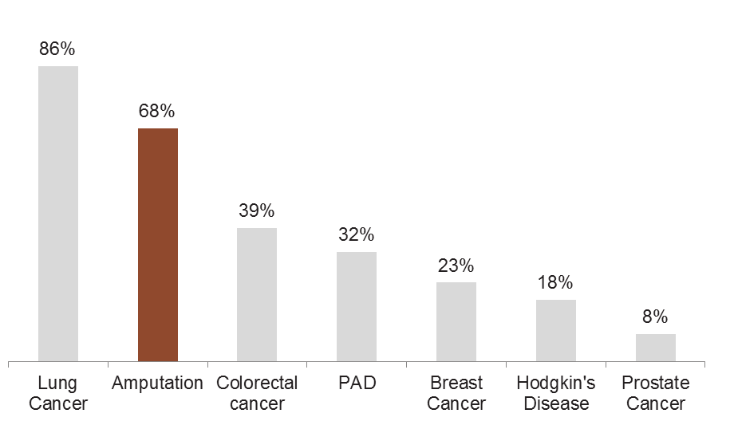
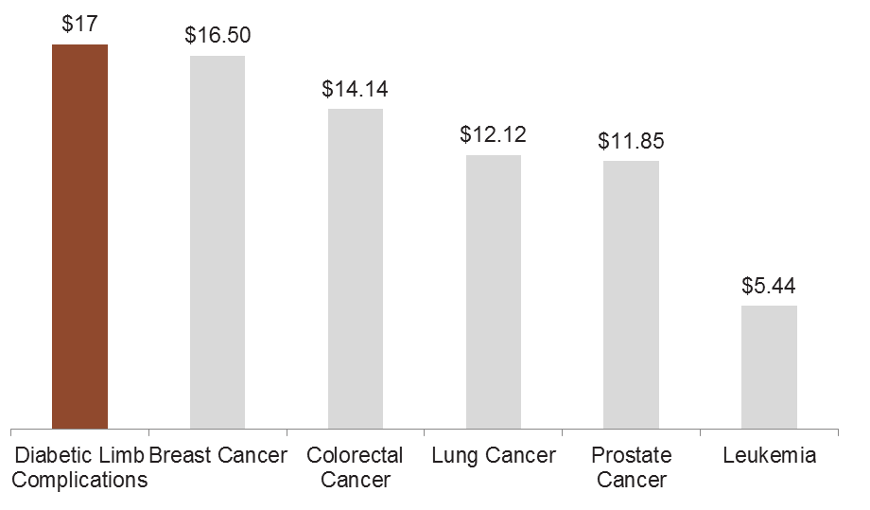
Compelling Industry Fundamentals Chronic Wounds can Lead to Costly and Deadly Amputations
Five Year Mortality Rate
When diabetic foot ulcers worsen into severe infection or gangrene, amputation is often required
Diabetic foot ulcers precede 84% of all diabetes-related lower limb amputations
60% of non-traumatic lower limb amputations occur in individuals with diabetes
50% of individuals that undergo an amputation will have a second amputation within 2 years
Large driver of systemic costs: total cost per patient $220,000
Direct cost of surgery + medical follow up (physical therapy, prosthetic devices, mental health)
85% of amputations are preventable with an integrated approach to treatment
Cost of Treatment ($ in Billions)
Sources: CDC, American Association for Diabetes, World Health Organization, Journal of the American Podiatric Medical Association, International Wound Journal, National Cancer Institute
Notes:
Emily kick’s off meeting.
Getting people oriented.
Emily will gather information for data room access.

Slide 7
Excellent Value Proposition For Key Constituents
Value to Patients
Customized treatment plans
Clinicians that specialize in the treatment of chronic wounds
Patient-friendly atmosphere
Exceptional patient satisfaction scores: 96% on average
Hospital Based Wound Center
Value to Panel Physicians
Value to Payors
Infrastructure designed to maximize patient throughput
Enables physicians to treat more patients
Additional revenue source: HBO therapy
Training to develop and hone clinical skills
Early intervention to prevent costly surgical procedures (amputation)
Superior quality outcomes
Forefront of data collection & benchmarking via participation in The Wound Care Quality Improvement Collaborative
Notes:
Todd
Also add commentary on AOSS/Competition

Slide 8
Protect Your Market from Loss of Referrals
Patients who would normally go to a competing hospital will now come to your wound center for world-class healing expertise
^{Primary Area}
^{Secondary Area}
^{Tertiary Area}
^{Primary Area}
^{Secondary Area}
^{Tertiary Area}
RestorixHealth Custom Professional/Community Education and Marketing Program Reaches Hospital Primary, Secondary and Tertiary Areas

Slide 9
Lucrative Spinoff Referrals from Wound Care Center
Radiology
About 75% of WCC Patients
X-ray
CT
Ultrasound
Bone Scan
Nuclear Medicine
Lab Work
About 35% of WCC Patients
Full Metabolic Panel
Hemoglobin A1c
Wound Culture
Surgery
About 25% of WCC Patients
Level 4.5 Debridement
Vascular
Skin Graft
WoundDocs® tracks spinoff referrals to other hospital based service lines
Notes:
Should these items be capitalized?

Slide 10
`
RestorixHealth’s Unique Business Models and Turnkey Approach

Slide 11
Innovative Contract Models
Percentage of Revenue
Restorix is paid a percentage of hospital collections
Flexible approach to partnering with hospitals – tailors contracts to meet specific needs
Innovative Percentage of Revenue (“POR”) contract
Designed as a shared risk / reward structure
Restorix is paid a percentage of the hospital facility fee
Aligns incentives between Restorix and hospital partner
Fixed Fee (“Per Click”)
Restorix is paid a specified rate for each treatment performed
Management Fee
Restorix is paid a fixed monthly fee for managing the center
Hybrid Fee
Restorix is paid a fixed monthly fee for its staffing expenses plus a “per click” fee for treatment
Contract Type
by Center
Notes:
Emily kick’s off meeting.
Getting people oriented.
Emily will gather information for data room access.

Slide 12
No Other Company Provides a More Complete and Turnkey Approach
RestorixHealth Provides...
The upfront capital investment
A best-in-class proven care model
The complete physical infrastructure – design, engineer and construct
All clinical and administrative staffing with daily hands-on management – no new hospital payroll or overhead to cover
Revenue cycle management for improved reimbursement
Training, physician education and community outreach
No one delivers the full package like RestorixHealth!

Slide 13
Proven, Repeatable Implementation Process Dedicated Development & Implementation Team
Replicable Development Process
Analytical Identification of Attractive Markets
Lead Generation for Potential Hospital Partners
Identify and Diligence Panel Physicians
Execute Contract with Hospital Partner
Obtain Licensing Approval
Build Out Center
Recruit and Train Staff
Referral and Community Marketing
Final Inspection / Approvals
Opening

Slide 14
Timeline to Success
120-180 DAYS
0-120 DAYS
TODAY
Continued growth and program refinement
^{Signed agreement}
^{We build} ^{the center}
^{Wound center grand opening}
^{Initial growth phase}
RestorixHealth designs and manages the construction of the center – start to finish
Dedicated team of implementation professionals to insure a timely and successful center opening

Slide 15
No Company Supports You More
On-site + Regional + Corporate Resources

Slide 16
Regional Management Structure Driving Results Field-based Resources Working in Concert to Drive Center Performance
Decentralized Management Structure
Enables center-level staff to focus on patient care
Operational Management
14 regions overseen by Regional Directors
Manage an average of 8 to 9 centers
Marketing and education activities to grow patient volume
Uncover opportunities to improve center-level efficiencies
Frequent face-to-face dialogue with hospital C-suite executives
Clinical Management
Directors of Clinical Training
Hiring clinical staff
Training clinical staff
Clinical performance reviews
Internal auditing
Documentation review
Quality assurance
Revenue Cycle Management
Regional A/R Reps
Coding teams
Close collaboration with hospital partners
Rigorous claims management strategies designed to increase hospital collections
Verification that hospital partners are adhering to contract remuneration requirements
Notes:
Emily kick’s off meeting.
Getting people oriented.
Emily will gather information for data room access.

Slide 17
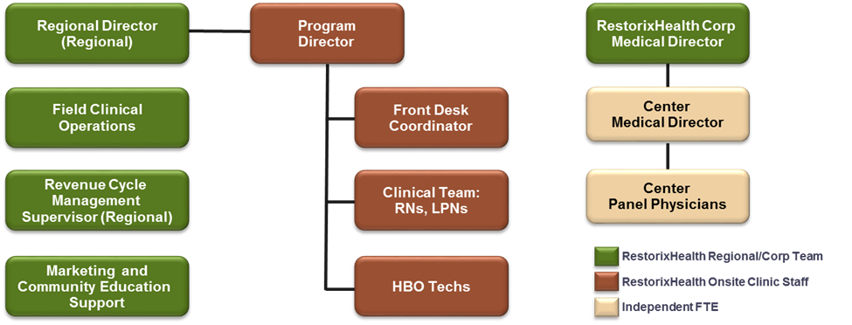
Your Wound Care Team

Slide 18
RestorixHealth Business and Clinical Support
Complete Revenue Cycle support – front end to back end
Charge master set-up and annual review
Pre-cert and authorization management
Letters of medical necessity
Payment adjudication and review
Denials management
Managed care contract review
Fully integrated WoundDocs® EMR
On-site Training
Clinical operations support
Utilization and indication review
Outcomes and quality management
TJC (The Joint Commission) preparedness
Quarterly quality indicator review

Slide 19
Our Marketing Approach
Direct-to-physician
Flyers, brochures, fax blasts, postcard mailings, grand rounds, physician dinners
Direct-to-hospital “four-wall”
Flyers, in-services, content for newsletters/lobby/website
Direct-to-consumer
Flyers, brochures, ads, health fairs, postcard mailings
Direct-to-payors
Carve-out contracting, billing and authorizations
Marketing
Program
Directors
RestorixHealth
Corporate
Marketing
Regional
Directors

Slide 20
Providing Comprehensive Clinical Care
Clinical Expertise + Outstanding Outcomes

Slide 21
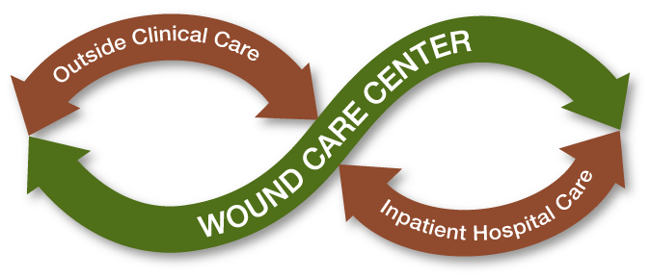
Integrating the Complete Continuum of Wound Care

Slide 22
Specialized Wound Care – 9 Chronic Wound Types Treated
Venous ulcers
Pressure ulcers
Arterial ulcer
Osteoradionecrosis
Necrotizing infections
Surgical wounds and burns
Soft-tissue radionecrosis
Diabetic lower extremity ulcers
Chronic refractory osteomyelitis
Accreditations:
UHMS Accredited Centers
Joint Commission Disease Specific Certified Centers

Slide 23
Intense Focus on Clinical Excellence
Proprietary wound-specific EMR
Drives adherence to clinical pathways
Robust data collection and reporting
Aids in clinical decision-making
Detailed clinical pathways for the treatment of chronic wounds
Grounded in evidence-based research
Standardizes approach to patient care
Increases clinical consistency
Outcomes tracking
Fully integratable with hospital partners’ IT
Proprietary WoundDocs
EMR
Clinical Pathways
In-House R&D Lab
40 hours of face-to-face training before center opens
Administered by Chief Medical Officer
Independent Board-level compliance committee
Corporate compliance committee
Dedicated Internal Quality Resources
Ongoing Clinical Training
Formalized corporate compliance program
Quarterly internal audits of all centers
Quarterly quality improvement plans
Digital library of over 75 proprietary e-learning courses
CME credits
Notes:
Emily kick’s off meeting.
Getting people oriented.
Emily will gather information for data room access.

Slide 24
What is Our Comprehensive Approach to Wound Care?
Deliver multi-disciplinary and physician-driven care throughout the continuum
Inpatient wound care integration
Nurse Liaison
Nurse Navigator
Provide case management and patient education
Develop the industry’s most advanced protocols – evidence-based clinical pathways
Assure appropriate use of integrated modalities to improve healing outcomes
Document and track healing results through our proprietary EMR
Utilize all appropriate and advanced wound care treatments
World-class wound care delivered with compassion!

Slide 25
Compression Therapy
Bio-Engineered Skin Grafts
Vascular Studies and Procedures
Negative Pressure Wound Therapy
Off Loading
Laboratory and Infection Control
Hyperbaric Oxygen Therapy (HBO)
Aggressive Debridement
Patient Education
Advanced Adjunct Therapies Ensure Comprehensive Care

Slide 26
Improved Outcomes Through Evidence-Based Clinical Pathways
Our pathways...
Are fully integrated into our EMR
Empower physicians with multiple care options based on the particular and unique needs of each patient
Assist physicians with proven pathways when need arises
Inform our clinical and educational efforts
Utilize nursing and medicine as multidisciplinary team
Standardize care across practitioners
Reviewed and updated clinical approaches annually

Slide 27
Advanced Technologies that Ensure Success – WoundDocs® and EMR Intelligence
HIPAA-compliant electronic medical records system
Manages patient information
Provides integrated scheduling
Tracks patient progress and treatment outcomes
Builds Superbills to support patient charges
Interfaces with your systems via encrypted messaging technology for transmitting HL7 Standard patient information
Features digital photography, billing and coding guidance, and automated electronic clinical feedback to referring physicians
Meets Meaningful Use requirements

Slide 28
Restorix Health – Best-in-Class Clinical Performance
Healing Rates – 88% excludes Palliative and Consult Patients
Median weeks to Heal < 5 weeks
Patient Satisfaction @ 96%
Based on Restorix Portfolio Experience - 110+ centers

Slide 29
Excellence Through Education – Onsite Professional Wound Care and HBO Training
Introductory courses in wound care and hyperbaric medicine using onsite and e-learning formats
Hyperbaric Medicine
40.5 hours AMA PRA Category 1 CME for physicians
40 contact hours by the Florida Board of Nursing
Wound Care
Skin and Wound Management Course® is approved by the National Alliance of Wound Care® Credentialing Board (NAWCCB) –The Credentialing Arm of the NAWC® for WCC Certification
Physicians — 22.75 Elective Credits (This activity has been reviewed and is acceptable for up to 22.75 Elective Credits by the American Academy of Family Physicians.)
Nurses — approved for 22.75 contact hours

Slide 30
Excellence Through Education – Continuing Education for Physicians, Staff and Patients
Area VP of Operations, Regional Director and Program Director are responsible for face-to-face professional and community education initiatives within your service area and hospital based departments and employees
Onsite educational dinners
Department and employee Lunch-n-Learns
Webinars
Monthly round table discussions
Onsite advanced wound care technology seminars
Supported by RestorixHealth’s CMO, physicians, corporate marketing team and regional clinical team

Slide 31
Performance Improvement and Quality Indicators
Clinical indicator report
Clinical practice pathways monitoring
Super-bill reconciliation
Hand-washing oversight
Wound care record review
Hyperbaric oxygen record review
Duration of wounds (case management)
Patient satisfaction
Referring physician satisfaction
TJC (The Joint Commission) readiness checklist
Sentinel event reporting
Hyperbaric chamber safety
Fire drill

Slide 32
Amputation Prevention Strategy

Slide 33
Amputation Prevention Center Strategy
In late 2014, Restorix formalized the strategy for Amputation Prevention Centers of America®
Leverage expertise in wound care to combat a costly and deadly problem
Multi-disciplinary team of physician coordinating care
Core team: vascular surgeons, surgically trained podiatrists and diabetologists
Consultative team: orthopedists, cardiologists, nephrologists, neurologists
Average of 3 procedures to stave off major amputation
Debridement
Vascular bypass to redirect blood flow
Bone restructuring
Wound Care Treatment + Surgical Services
Multi-disciplinary Team of Physicians
Integrated Procedures
Limb Preservation / Cost Reduction / Quality of Live Improvement
Notes:
Matt

Slide 34
Amputation Prevention Center Strategy
Benefits to Payors
Benefits to Hospital Partner
Decreased major amputation rates
Decreased healthcare costs
Increased stickiness with hospital contracting
Increased surgical volumes
Increase in referrals to other service lines
Cardiology and plastics
Differentiated value-added service that attracts patients
Bolt-on offering to existing comprehensive wound care centers that have the patient volume and acuity as well as specialized physicians to support the strategy
De novo opportunity for 500 identified hospitals in major markets
Ability to draw patients from tertiary markets
Contiguous to exiting RestorixHealth wound care centers to create a “hub and spoke” footprint
Works well integrated Delivery Systems – Hub and Spoke model
Notes:
Matt

Slide 35
Why No Other Partner Compares
Exclusive Advantages + Exceptional Outcomes

Slide 36
RestorixHealth Partner Advantages
Comprehensive Approach
Extensive Support Network
Quality and Performance
Standardized Care Practices
Improving Best Practices
Polices and Procedures
Marketing/Referral Development
Wound-Specific EMR
Onsite Training
and Education
Revenue Cycle Partnership
Outstanding Patient Outcomes
Vested Business Partner
No One Does More for Your Success!

Slide 37
The RestorixHealth Difference
RestorixHealth
Competitors
Hospital Contracts
Flexible fee structures
Preference for revenue share
Monthly management fee
Program director
Clinical director
Registered nurses
Hyperbaric technicians
Front desk staff
Program director
Employed Staff
Field-based resources:
Marketing to drive patients
Clinical oversight
Operations oversight
RCM support
Centralized
Center Oversight
Contract Retention
98% over last 2 years
Annual “churn” of ~15%
Notes:
Todd
Also add commentary on AOSS/Competition

Slide 38
Final Points to Remember
Exceptional Clinical Outcomes
Project Capitalization
Comprehensive Revenue Cycle Management
Convenient Onsite Training
No One Does More for Your Success than RestorixHealth!

Slide 39
Discussion

