Slide 1
GS1 Data Standards

Slide 2
Agenda
Introduction
GS1 Data Standards Overview
Benefits of GS1 Data Standards
Adoption Challenges
Medline’s Experiences
Questions?

Slide 3
GS1 Data Standards Overview
Who is GS1?
GS1 is a not for profit organization that helps many industry groups (i.e. retail, automotive, food, healthcare) with adoption and use of data standards.
GS1 Healthcare US is the user group that supports the adoption and implementation of global data standards within the US healthcare industry.
What are the GS1 Data Standards?
There are two main GS1 data standards in supply chain:
GLN = Global Location Number.
GTIN = Global Trade Item Number

Slide 4
Global Location Number (GLN)
A GLN is a unique 13 digit number assigned to locations within the healthcare supply chain.
The GLN can identify: a physical entity, such as a warehouse or a hospital wing, par location; or a legal entity or trading partner, such as a specific company or supplier
GS1 is the “keeper” of GLN’s to partners in the supply chain & are saved in the “GLN Registry” which is a shared “address book” for all GLN’s.
Most Common Uses for GLN are:
Ship-To Location on PO’s
Used in GPO Rosters / Membership Lists
Ensures trading partners are referencing the “same” location

Slide 5
Global Trade Item Number (GTIN)
Global Trade Item Numbers (GTINs) are a 14 digit number which uniquely identify items in the Supply Chain.
Brand Owners / Manufacturers of healthcare items must properly enumerate (assign a GTIN) and maintain their GTIN’s for their respective items.
GS1 provides a numbering sequence such that each manufacturers items will have a unique GTIN (no two the same).
GTIN’s can be represented in a standardized barcode format to enable scanning an item throughout the supply chain.
Medline Catalog Item: NON27420 (Face Shield)
GTIN = 40080196721741

Slide 6
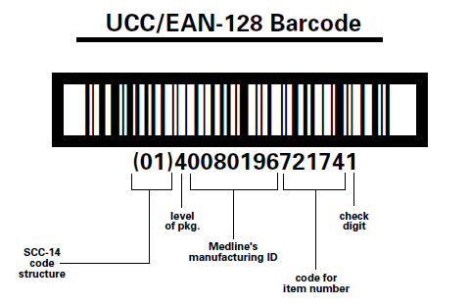
Global Trade Item Number (GTIN)
Manufacturer
GPO
Provider
Distributor
How Are GTINs Used?
All parties in the supply chain are using the same item number for the same item.
GTIN’s can be used in PO’s, Invoices, Contracts, Reports, etc. to ensure “same item” information amongst partners.
GTIN’s will be used by computers to accurately line up item master data in respective systems.
Mfr Item: NON27420

Slide 7
GS1 Benefits
GS1 Barcoding Standard Benefits:
Fast and accurate data capture at every point in the supply chain
More accurate EMR Integration for Patient Charging
The ability to automate warehousing
Better control over distribution and storage
Improved company to company communications throughout the supply chain
One standard for use with all trading partners, therefore no conflicting demands
Reality: Need more stakeholders participating to provide industry best practices and to truly document ROI to help cost justify implementation.

Slide 8
Adoption Challenges
Why So Little GLN Adoption?
Goal: The anticipation was providers and suppliers would use them transactionally in PO’s.
Reality: Very few providers adopted use of the GLN as Providers didn’t see the benefit in the GLN, but did/do see the benefit in the GTIN, “so let’s wait for those.”
Why So Little GTIN Adoption?
There has been no regulatory requirement to do so.
There are real costs to adopting and implementing the GS1 data standards.
Most suppliers have already made the investments in systems to support the use of the GLN and GTIN.
Providers need to make it a priority to allocate resources and upgrade their systems to use the standards.
Barcode Challenges

Slide 9
Medline’s Experiences
GS1 Data Standards Support
Medline was a founding member of GS1 US Healthcare workgroup & is still actively involved
As a manufacturer, Medline has enumerated (assigned GTIN’s) to Medline Brand items.
As a distributor, Medline actively reaching out to manufacturing community to gather GTIN data for distributed products.
Dedicated resources in our Item Master Department and Quality Assurance areas to ensure proper coding and packaging requirements are being met.
GLN & GTIN Transactions
Transacting with many customers using the GLN
GTIN’s daily transactions with 1 large IDN (Implementing another IDN currently)

Slide 10
Questions?

